Slide 1
Understanding Customer Satisfaction based on Olist Store E-commerce Dataset
Deyan Tsvetkov
Ivan Kalchev
10.07.2024

Slide 2
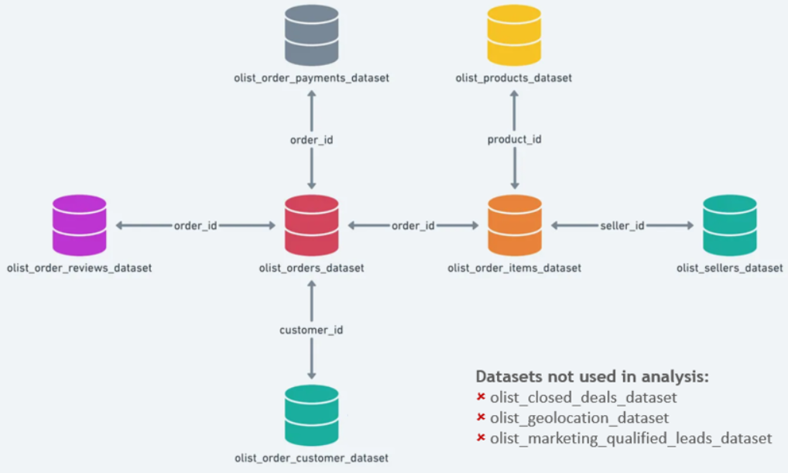
Data preprocessing
Olist data contains 99,441 unique orderIDs from 2016 to 2018
Data is divided into 10 separate datasets
For our analysis on customer satisfaction, we use 7 of those datasets
Merged the 7 datasets into a single denormalized csv file using pandas in Google Colab
Excluded 775 orders with no order items; 749 orders with no review score and 1 order with no payment information
Included only the latest review score for orders with more than one review score
Final merged dataset includes 97,916 unique orderIDs

Slide 3
Methodology
Our analysis relies on PowerBI model, correlation matrix, linear regressions and random forest
Assumptions:
Created additional metrics to better understand customer satisfaction
Purchase Delivery Days = customer delivery date – purchase date
Satisfied = review score >= 4; Not Satisfied = review score < 4
Late vs Early/On Time delivery = customer delivery date – estimated delivery date
Purchase Month = the month of the purchase timestamp
Freight to Price Ratio = freight value / price
Seller Delay Days = order delivered carrier date – shipping limit date

Slide 4


Methodology

Slide 5
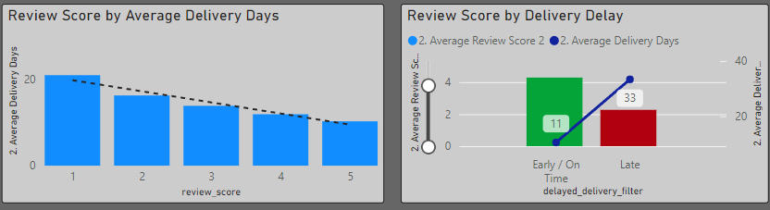
Review Score by Average Delivery Days and Delivery Delay
1
2
Review scores of 4 or 5 have are delivered for 10.6 days on average. Orders with review scores of 3 or below are delivered for 17.4 days on average which represents 64% increase in delivery time
Late deliveries have an average score of 2.7 vs score of 4.3 for deliveries that are either early or on time
1
2

Slide 6
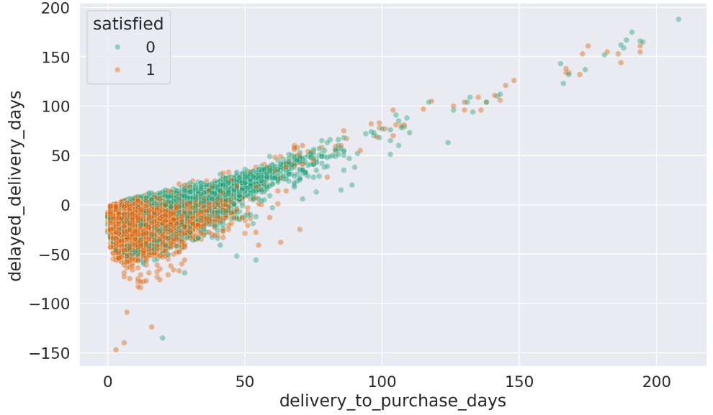
Satisfied Scatter Plot
Most satisfied reviews for orders that came early and that took up to 30 delivery days
A lot of negative reviews (review score < 4) observed if the delivery is late

Slide 7
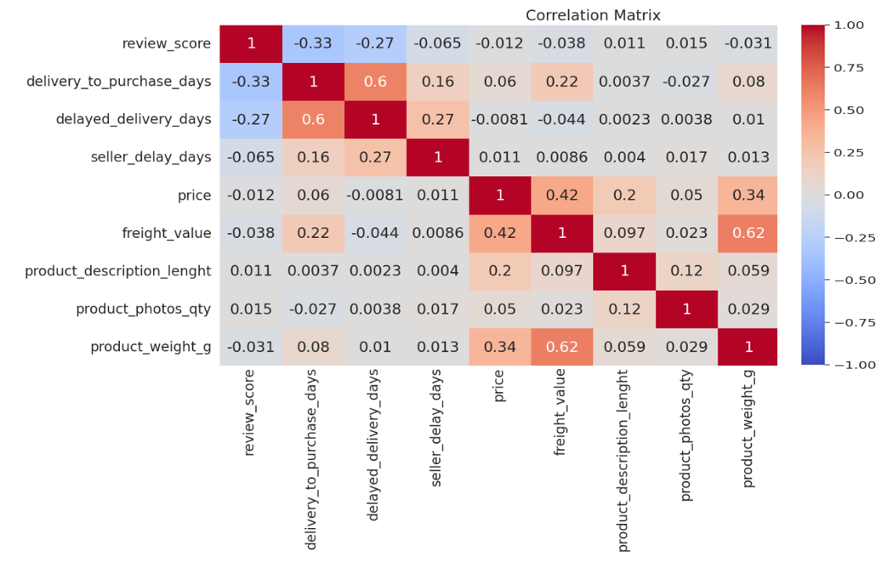
Correlation Matrix
Further linear regression testing with the top 3 features that have highest correlation with review score
All metrics tested with Random Forest

Slide 8
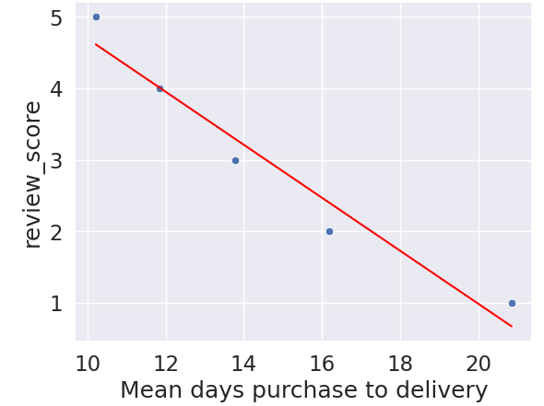
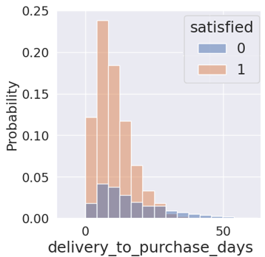

Review Score vs Purchase to Delivery Days
Fewer delivery days corresponds to higher review score
Review score decreases with 0.37 points with every additional delivery day
Not satisfied customers increase relative to satisfied ones when delivery days increase

Slide 9
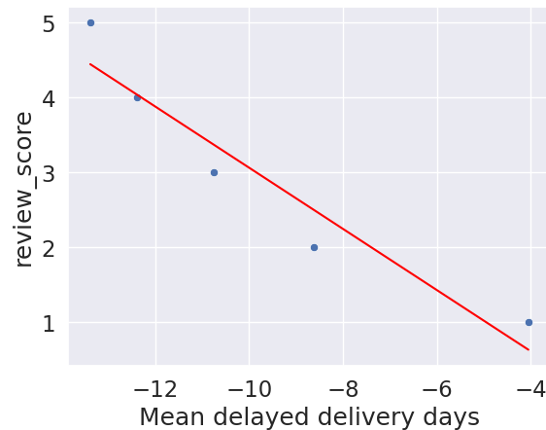
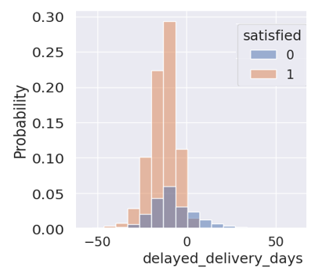

Review Score vs Delayed Delivery Days
Orders with more delay in their deliveries tend to have more negative reviews
Review score increases with 0.41 points for every early delivery day
Not satisfied customers increase considerably compared to satisfied if the order is received with a delay

Slide 10
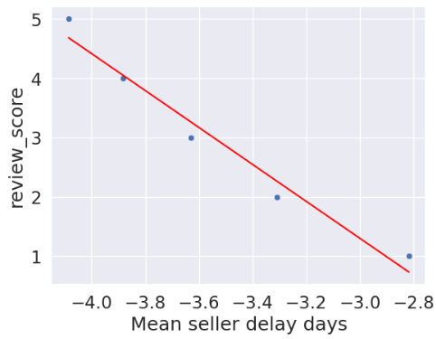

Orders delayed from the seller side also seem to affect review scores
All review score observations clustered between (-2.8) and (-4) days
Difficult to interpret whether a seller delay alone has an effect on review score
Seller delay might indirectly affect review scores by increasing average delivery days and the possibility that the order arrives late

Slide 11
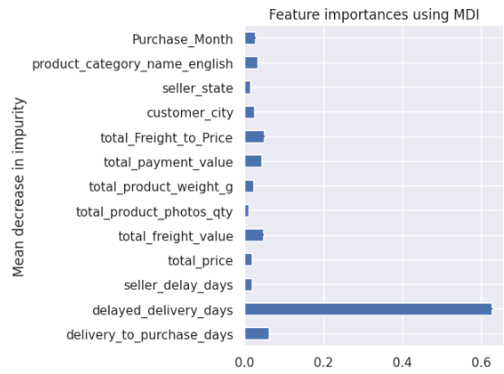
Random Forest
0.049
0.048
0.627
0.061
Delay in delivery vs estimated is classified as the most important feature that affects review score according to the model
From a customer perspective it makes sense that delay in delivery has higher effect on review score than actual purchase to delivery days as it is related to customer expectations

Slide 12
Recommendation:
Whether delivery is received early or on time and overall delivery days seem crucial to review score
In order to reduce orders that are late Olist can:
Extend their carrier network and use services from more providers, especially during busy periods
Include a few days buffer for estimation date (i.e. show later estimated delivery date), especially for products that are not performing well in terms of delivery or when busy period ahead

